Slide 1



Suicide Prevention Strategies in Special Populations
American Society of Hispanic Psychiatry
Annual Meeting Program and Reception
Saturday, May 20, 2017- 1:00 pm
Hilton Bayfront Hotel – Cobalt 520 Room

Slide 2
Suicide Prevention Strategies in Special Populations
1:00-1:15 pm Welcome - Carlos Zarate - ASHP President 2016-2017
1:15-1:45 pm Neurobiology/ Novel Treatment Suicide, Carlos Zarate
1:45-2:05 pm Suicide Prevention Interventions for Adolescents- Sebastian Cisneros
2:05-2:35 pm Suicide in Physicians - Ruby Castilla-Puentes
2:35-3:05 pm Suicide Risk in Older Adults: Bernardo Ng
3:05-3:35 pm BREAK
3:35-4:05 pm Global Mental Health -- Focus on Latin America, Javier Escobar
4:05-4:35 pm Feedback and Discussion
4:35-5:00 pm Update on Collaborations: Mauricio Tohen, Alvaro Camacho,
Juan A. Gallego, Mercedes Perez-Rodriguez, Bernardo Ng, Gerardo
Villarreal, Oscar Jimenez, and Ruby Castilla-Puentes
5:00-7:00 pm Reception

Slide 3
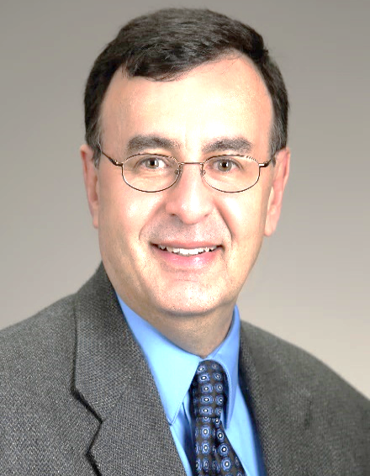
Carlos A. Zarate, MD
Carlos A. Zarate, M.D. is Chief of the Experimental & Therapeutics Branch and of the Section on Neurobiology and Treatment of Mood and Anxiety Disorders, and Senior Tenured Clinical Investigator, Division Intramural Research Program, National Institute of Mental Health, Clinical Professor of Psychiatry and Behavioral Sciences, George Washington University and Professor of Psychiatry and Behavioral Sciences, Howard Medical School. Dr. Zarate completed his residency training in psychiatry at the Massachusetts Mental Health Center/Brockton VAMC division.
He later completed a fellowship in Clinical Psychopharmacology at McLean Hospital of the Consolidated Department of Psychiatry, Harvard Medical School and remained on staff at McLean Hospital as the Director of the Bipolar and Psychotic Disorders Outpatient Services.
From 1998 to 2000 Dr. Zarate was the Chief of the Bipolar and Psychotic Disorders Program at the University of Massachusetts Medical School. In 2001, he joined the Mood and Anxiety Disorders Program at NIMH. His achievements and awards include the Ethel-DuPont Warren Award and Livingston Awards, Consolidated Department of Psychiatry, Harvard Medical School; Outstanding Psychiatrist Research Award, Massachusetts Psychiatric Association; Program for Minority Research Training in Psychiatry, APA; the National Alliance for Research on Schizophrenia and Depression Young Investigator Award; National Alliance for Research on Schizophrenia and Depression Independent Investigator Award; the National Institutes of Health Director’s Award Scientific/Medical, the 2011 Brain & Behavior Research Foundation Award for Bipolar Mood Disorder Research, the 2013 National Institute of Health Director’s Award—Scientific/Medical Achievement and Mogens Schou Research Award: Bipolar Disorder and the Simon-Bolivar Award American Psychiatric Association; 2015 Ruth L. Kirschtein Mentoring Award NIH and the Astute Clinician Lecture Award, NIH.
Dr. Zarate is a fellow of the American College of Neuropsychopharmacology and a member of the Society of Biological Psychiatry and the Society for Neuroscience. Dr. Zarate’s research focuses on the pathophysiology and development of novel therapeutics for treatment-resistant mood disorders as well as the study of biomarkers and neural correlates of treatment response.

Slide 4
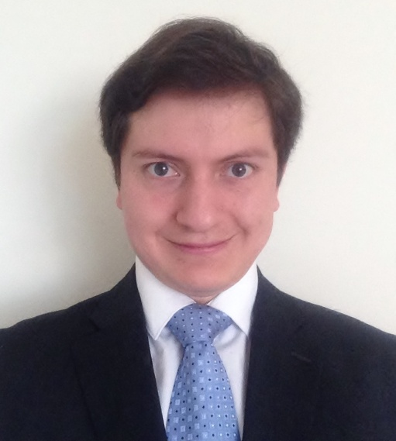
Sebastian Cisneros, MD
Dr. Cisneros obtained his medical degree at the Pontifical Xavierian University in Bogota, Colombia. He is currently doing his residency training in Psychiatry at Rutgers New Jersey Medical School.
His Research interest include the neurobiology of suicidal behavior, exploring the contributory factors of serotonergic dysfunction, stress and inflammation. He is also studying the diverse community based interventions for suicide prevention in children and adolescent.
He is a member of the American Psychiatric Association, New Jersey Psychiatric Association and Colombian Society of Biological Psychiatry.
Dr. Cisneros is a young promise of Latin American Psychiatry and is pursuing an academical career in the United States based on clinical training, research and teaching.

Slide 5
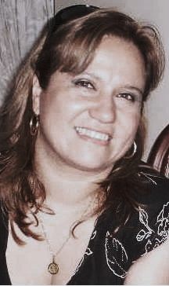
Ruby C. Castilla-Puentes, MD, DrPH, MBA
Ruby C. Castilla-Puentes, MD is the Medical Safety Officer supporting the Global Medical Safety Division of Johnson & Johnson Medical Devices, as well adjunct professor of Pharmacoepidemiology and Epidemiology at Temple and Drexel Universities of Philadelphia.
Her research interests are: pharmacoepidemiology, psychiatric epidemiology (in Latin American countries), and medical devices and drug-development /safety interface. Her educational and training interests involve lecturing medical students, residents and graduate students, as well as participating as a graduate faculty in psychiatric-epidemiology and psychopharmacology coauthored several papers in areas such as psychopharmacology in children, and epidemiology of dementia and mood disorders.
Dr Castilla-Puentes was named Chairperson of the Corporate Advisory Board for the National Hispanic Health Foundation/ National Hispanic Medical Association, in 2014 and currently serves as member of the Board of Directors for the American Society of Hispanic Psychiatry. She is a distinguished fellow of the American Psychiatric Association and a long-term member of many associations, including the International Epidemiological Association, International Society for Bipolar Disorders and American Medical Association. In addition, she is an ad hoc reviewer for the Journal of Nervous and Mental Disease, European Heart Journal, Journal of General Hospital Psychiatry and Schizophrenia Research. Recently she completed an Executive MBA at the University of Pittsburgh, Katz School of Business, with a concentration in Global and International Business.

Slide 6
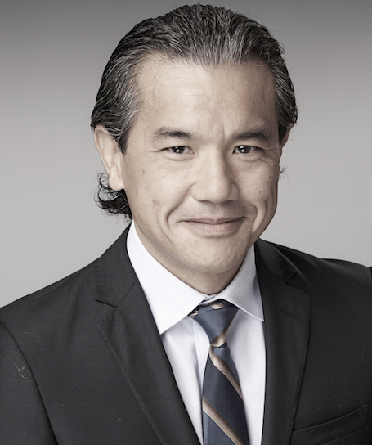
Bernardo Ng, MD
Dr. Ng was born in Mexicali, Mexico. He got his medical degree at the University of Nuevo Leon in Monterrey, Mexico. He completed residency in Psychiatry at Texas Tech University in El Paso, Texas, and a Fellowship in Psychosomatic Medicine at the University of California San Diego, in La Jolla, California.
He has certification in Psychiatry and Psychosomatic Medicine by the American Board of Psychiatry and Neurology, and certification in Psychiatry by the Mexican Board of Psychiatry. His research interests include rural psychiatry, United States and Mexico border issues, elderly and dementia related disorders.
Dr Ng is an Assistant Professor of the department of Psychiatry at the University of California, San Diego. He is the medical director of Sun Valley Behavioral and Research Centers in Imperial California and Nuevo Atardecer Geriatric Center in Mexicali Mexico.
He is a distinguished fellow of the American Psychiatric Association and vice-president of the Mexican Psychiatric Association

Slide 7
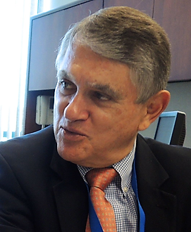
Javier Ignacio Escobar Soto, MD, MS
Associate Dean for Global Health, UMDNJ-Robert Wood Johnson Medical School, New Brunswick, New Jersey .and Professor, Departments of Psychiatry and Family Medicine, Robert Wood Johnson Medical School, New Brunswick, New Jersey, USA.
After being the chair of psychiatry for over a decade, Dr. Escobar created and has led the Office of Global Health at RWJMS, the only formal program of its kind at Rutgers-RBHS since 2008.
Dr. Escobar’s national assignments have included (currently or recently):
Member, DSM-5 Task Force that produced the New Diagnostic Manual in Psychiatry (DSM-5) (2008-2013).
Member, National Advisory Committee, the Robert Wood Johnson Foundation, Clinical Scholars Program, Princeton, New Jersey (2010-2017)
Member, Institute of Medicine Committee recommending treatments for the chronic multi-symptom illness in veterans returning from the Persian Gulf (2012-2013)
Member, Institute of Medicine Committee providing an update on Gulf War Illness” (2015-2016).
.
Prior to coming to New Jersey, Dr. Escobar was interim Chair of Psychiatry at the University of Connecticut School of Medicine, Professor of Psychiatry at UCLA and held academic appointments at the University of Minnesota and the University of Tennessee. Dr. Escobar has received significant NIH research funding and led a center grant from NIMH. He also led for almost two decades a successful NIH-funded mentoring program to develop new researchers in the area of Latino Mental Health. Currently his research activities focus on the global arena as consultant and co-investigator of NIH-funded research in Colombia and Argentina examining the genetics of bipolar disorder and schizophrenia.
Dr. Escobar has been also an advisor to the director of the National Institute of Mental Health, the US Food and Drug Administration, the World Health Organization and he has served in multiple research review committees in the United States and Canada.

Slide 8
Thanks! Gracias!

