Slide 1

ASHP-2020
Our Board Members
Ruby Castilla-President
Juan Gallego- Elected President
Pamela Montano- Secretary
Gerardo Villarreal- Treasurer
Nancy Colimon
Hector Colon-Rivera
Michelle Dickinson
Sandra Duarte
Fernando Espi
Fructuoso Irigoyen
Daniel Jimenez
Roberto Lewis-Fernandez
Ivan Montoya
Mercedes Perez
Bernardo Ng
Carlos Zarate
Mauricio Tohen
Frances Bell

Slide 2
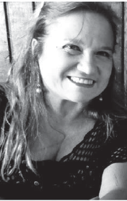
Dr. Castilla-Puentes is a Colombian psychiatrist, serving as the President of the American Society of Hispanic Psychiatry from 2020-2022 and Leading Medical Strategies at the Hispanic Organization for Leadership and Achievement (HOLA) and Mental Health Diplomats, J&J employee resources groups.
She is a Director of Clinical Development Neuroscience, at Janssen, as well as adjunct Professor of Psychiatry and Pharmacoepidemiology at the Universities of Penn, Temple and Drexel.
She obtained her M.D. from the Universidad Industrial de Santander, School of Medicine and went on to do a residency in Psychiatry at Javeriana University, in Bogota.
She is one of the founders of WARMI (woman in Quechua), a network dedicated to promoting women's mental health.
Ruby Castilla-Puentes, MD, DrPH, MBA

Slide 3
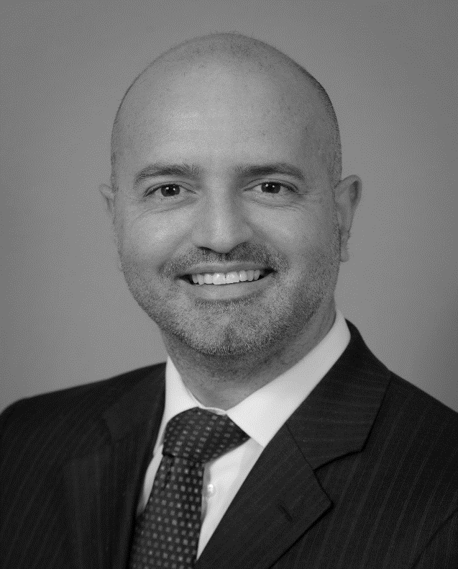
Dr. Gallego is a Colombian physician-scientist and psychiatrist.
He is an Assistant Professor of Psychiatry at the Zucker School of Medicine at the Zucker School of Medicine at Hofstra/Northwell and he is the Director of the Early Phase Psychosis Biomarker Laboratory at The Zucker Hillside Hospital in New York.
Juan A. Gallego, MD

Slide 4
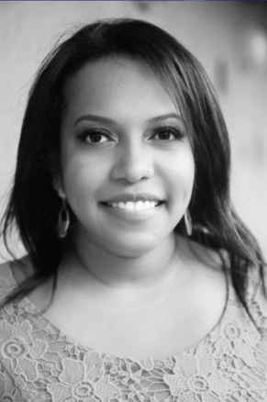
Dr. Montaño Arteaga is currently Assistant Clinical professor at NYU School of medicine and the Director of the Latino Bicultural Clinical at Gouverneur Health/NYU Health and Hospitals. She was born in Buenaventura, a town located in the Colombian Pacific Coast.
Her main areas of focus are advocacy and education in immigrant and minority mental health. She is the National Chairwoman of the Council of Young Physicians of the national Hispanic Medical Association (NHMA).
Pamela Montaño Arteaga, MD

Slide 5
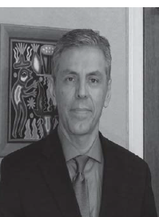
Dr. Villarreal is a Mexican psychiatrist.
He is a Professor of Psychiatry and
Neurosciences at the University of New Mexico School of Medicine.
He is also the director of the Cognitive Behavioral Therapy training at the UNM psychiatry residency program.
Dr. Villarreal interests include the neurobiology and treatment of PTSD, medical informatics and data mining.
He has published studies on neuroimaging and psychopharmacology of PTSD.
Gerardo Villarreal, MD

Slide 6
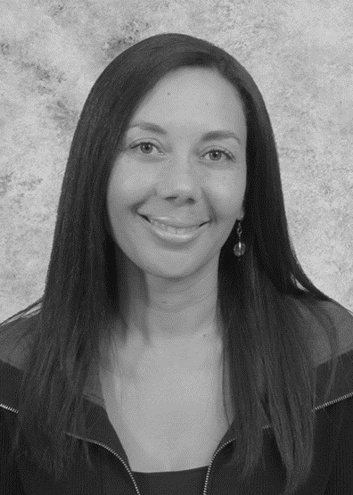
Dr. Colimon is a Colombian psychiatrist and the current Chief operations officer and Innovations Director of “Nuevo Atardecer” in Mexicali, Baja California
Dr. Colimon completed a Fellow in Neuropsychiatry from the University of Illinois, and she is a Board Member from the ASHP and the former president of the Colombian Association of Biological Psychiatry.
Nancy Colimon, MD

Slide 7
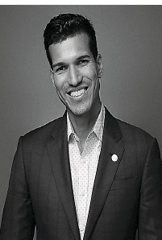
Dr. Colón-Rivera is a general, adolescent, and addiction psychiatrist of the Pennsylvania medical community. He is the Director of the Asociación Puertorriqueños en Marcha, Inc (APM), a non-profit organization dedicated to improving the quality of life of Hispanic communities through direct behavior and substance use disorder services in the Philadelphia region.
Dr. Colón-Rivera is currently a faculty member at the University of Pittsburgh, the President of the American Psychiatric Association Hispanic Caucus and a Board member of the American Society of Hispanic Psychiatry ASHP.
Hector Colon-Rivera, MD

Slide 8
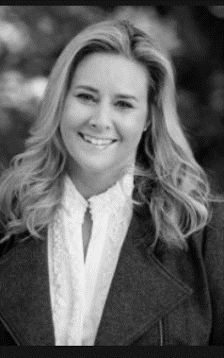
After writing “Breaking into My Life,” Michelle felt a deep desire to create a positive and lasting impact in the field of mental health.
Michelle is an active member of the board of director of the American Society of Hispanic Psychiatry
Michelle Dickinson

Slide 9
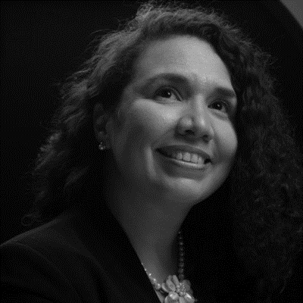
Dr. Duarte Sckell is Board Certified in Psychiatry and Psychosomatic Medicine by the American Board of Psychiatry and Neurology.
Dr. Duarte completed her residency in Psychiatry at Washington University in St. Louis, Missouri, and specialized in Psychosomatic Medicine-Consultation Liaison at Yale University in New Haven, Connecticut.
Dr. Duarte is very passionate about demystifying psychiatric disorders, helping identify the correct diagnosis and treatment to help patients and their families live fulfilling lives.
Sandra Duarte-Sckell, MD

Slide 10
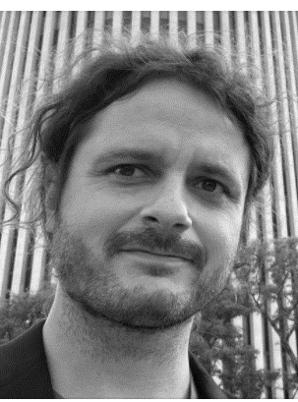
Dr. Fernando Espi Forcen was born and raised in Murcia, Spain.
After graduating from Medical School, he moved to the US to pursue training in General Psychiatry at MetroHealth Medical Center in Cleveland, OH.
He finished a fellowship in Child and Adolescent Psychiatry at The University of Chicago and in Psycho-Oncology at Memorial Sloan Kettering Cancer Center in NYC and currently is an Assistant Professor Department of Psychiatry and Behavioral Sciences, Rush Medical College.
Fernando Espi-Forcen, MD

Slide 11
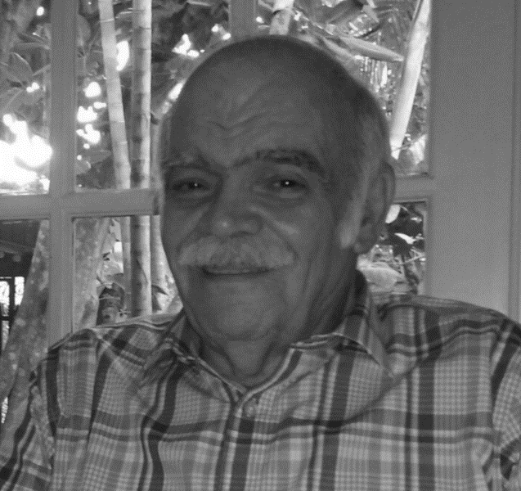
Dr. Irigoyen is a practicing psychiatrist in McAllen and a Physician Advisor for the Behavioral Hospital at Renaissance in Edinburg, both in the Rio Grande Valley in Texas.
He was born and raised in Chihuahua, Mexico where he attended medical school.
After graduation, for 10 years he worked as a physician with the Tarahumara Indians in the mountainous part of the state.
He is a Distinguished Life Fellow of the APA and a Board member of ASHP.
Doctor Irigoyen has published extensively on the Tarahumara Indians and in psychiatry on PTSD, Alzheimer’s disease and depression.
Fructuoso Irigoyen, MD

Slide 12
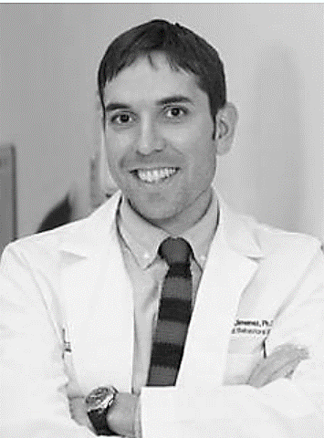
Dr. Jimenez is an associate professor in the Department of Psychiatry and Behavioral Sciences at the University of Miami Miller School of Medicine.
He has experience in aging research and has dedicated his career to improving access and engagement in mental health services among underserved populations.
Daniel Jimenez, PhD

Slide 13
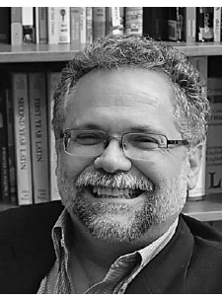
Dr. Lewis-Fernandez is Professor of Clinical Psychiatry at Columbia University and Director of the New York State Psychiatric Institute Center of Excellence for Cultural Competence.
He is a cultural psychiatrist, focusing on developing culturally valid interventions and instruments to enhance patient engagement, reduce misdiagnosis, and help overcome disparities in the care of underserved cultural groups.
He is the lead developer of the DSM-5 Cultural Formulation Interview.
Roberto Lewis-Fernandez, MD

Slide 14
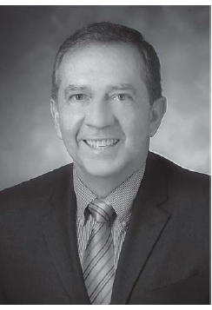
Dr. Montoya is a Colombian psychiatrist and epidemiologist who specializes in the
development of therapeutics for Substance Use Disorders
(SUDs).
He is the Deputy Director Division of Therapeutics and Medical Consequences (DTMC)
National Institute on Drug Abuse. He is a Board member of our ASHP and collaborates in research projects, with Spain and Latin American countries.
Ivan Montoya, MD

Slide 15
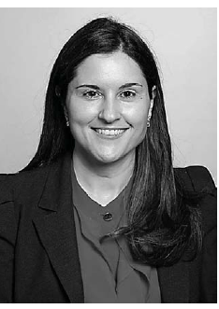
Dr. Perez is an Assistant Professor of Psychiatry
Director, Medical Student Clerkship, Associate Director, Medical Student Education, Assistant Training Director for Research, Icahn School of Medicine at Mount Sinai
Icahn Medical Institute New York, NY.
Dr Perez is a Fellow Member of the American Psychiatric Association, a Member of the American College of Psychiatrists, an Associate Member of the American College of Neuropsychopharmacology (ACNP), and member of the board of directors of the American Society of Hispanic Psychiatry.
Maria de las Mercedes Perez-Rodriguez, MD, PhD

Slide 16
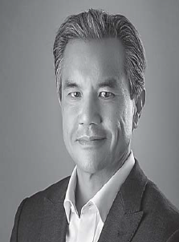
Bernardo Ng is a Mexicali native who started his private practice in Imperial County in 1994. He became a Medical Doctor at the University of Nuevo Leon, Mexico. After completing his year of social service in
the city of Monterrey in 1988, he entered specialized training in Psychiatry, in El Paso Texas in 1989 and continued in San Diego California in 1992.
He is certified by the American Board of Psychiatry and Neurology in General Psychiatry and in Psychosomatic Medicine. He has served as President and member of the ASHP. He is a consultant at various organizations and clinics. He is a member of the American Psychiatric Association, the Imperial County Medical Society, the San Diego Psychiatric Society and the American Medical Association.
Bernardo Ng, MD

Slide 17
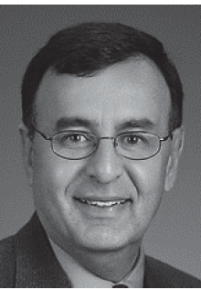
Dr. Zarate is Chief, Section on the Neurobiology and Treatment of Mood Disorders and Chief of Experimental Therapeutics and Pathophysiology Branch (ETPB) at the National Institute of Mental Health, and Clinical Professor of Psychiatry and Behavioral Sciences, at The George Washington University.
Dr. Zarate’s current research focus is on developing novel medications for treatment-resistant depression and bipolar disorder. His areas of expertise include biological and pharmacological aspects of mood disorders in adults.
He was born and race in Cordoba, Argentina and served as President and member of the ASHP.
Carlos Zarate, MD

Slide 18
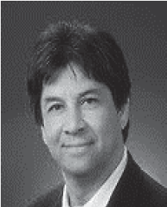
Dr Tohen was born and raised in Mexico City. He earned his medical degree from the National University of Mexico and his Doctorate in Public Health (Epidemiology) from Harvard University.
His postdoctoral training included a residency in Psychiatry at the University of Toronto and a fellowship at McLean Hospital, Harvard Medical School. Dr Tohen also obtained an MBA degree from the Indiana University Kelly School of Business. Dr. Tohen is Professor and Chairman at University of New Mexico Department of Psychiatry.
He has served as President and member of the ASHP.
Mauricio Tohen, MD

Slide 19
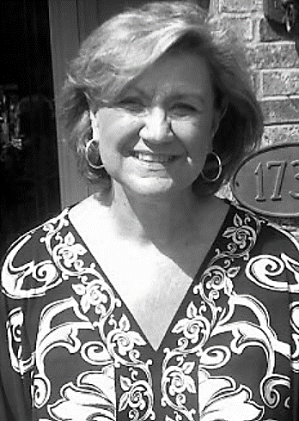
Frances came to work supporting the Society's administrative work in 2012.
If you have some question on the history, membership, meetings, by laws and future of the ASHP, Frances is the person who answers us all these questions.
Frances provides her experience making ASHP stronger every day.
The Central Office is maintained in Dallas, Texas.
Frances Bell

