Slide 1

Virtual Celebration Event
Celebracion Virtual
END OF YEAR 2020 & ASHP LIFETIME ACHIEVEMENT AWARD CEREMONY
CELEBRACION DE FINAL DE AÑO 2020 ASHP & ENTREGA DE LOS RECONOCIMIENTOS POR AÑOS DE SERVICIO
Welcome!!! Bienvenidos!!

Slide 2


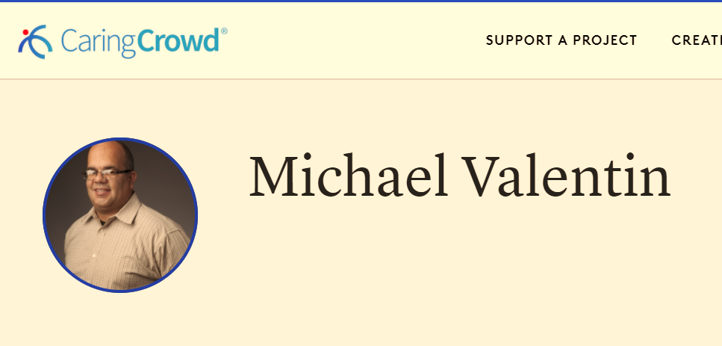
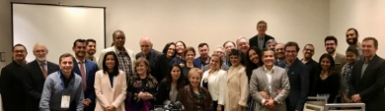
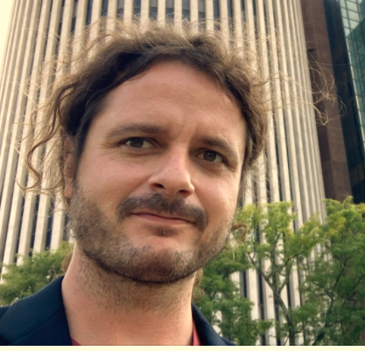
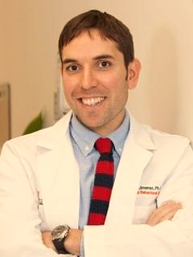

Welcome and Remarks by the ASHP President
In the middle of the mist caused by the coronavirus, we published a book and launched 3 campaigns: to increase our finances and to increase our visibility in the social networks.
Michael Valentin
http://www.americansocietyhispanicpsychiatry.com/
More than 90 members from the Hispanic community were recognized in the book “Quijotes de la psiquiatria” published in August of this year.
Fernando Espi
Daniel Jimenez

Slide 3
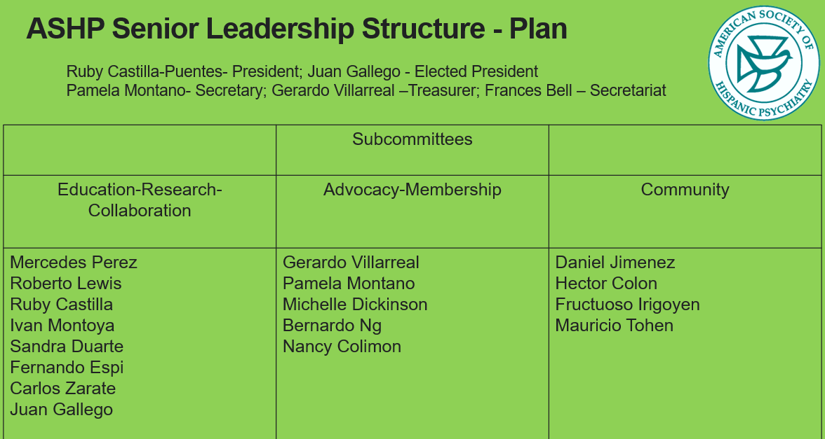
Welcome and Remarks by the ASHP President
Two Symposium Proposals submitted by ASHP were accepted for our next APA 2021 annual meeting.
.
Welcome New Board Members:
Ruben Taborda
Yaid A. Puente
Jose Canaca
We're here for you and to serve you.
This is a very exciting time to become involved in our organization!
We want to be closer and establish more collaborations with our colleagues in Latin America

Slide 4
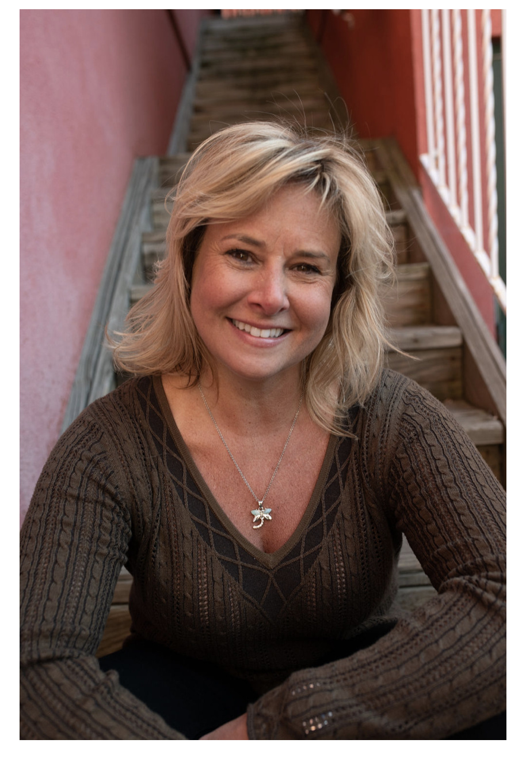
Michelle E. Dickinson
Author
TEDx Speaker
Mental Health Advocate
Change Maker

Slide 5


Slide 6
Future of ASHP and Plans for 2021
Dr. Juan Gallego
Elected-President

Slide 7


Happy Holidays
Felices Fiestas

