Slide 1

Virtual Celebration Event
Celebracion Virtual
END OF YEAR 2020 & ASHP LIFETIME ACHIEVEMENT AWARD CEREMONY
CELEBRACION DE FINAL DE AÑO 2020 ASHP & ENTREGA DE LOS RECONOCIMIENTOS POR AÑOS DE SERVICIO
Welcome!!! Bienvenidos!!

Slide 2


Presentation - Toast to the ASHP 2020 Lifetime achievement awardees
ASHP Lifetime Achievement Award
In 2020 we are recognizing a group of physicians, clinicians, and mental health professionals who have dedicated to serving Hispanic/Latino children, adolescents, and families (e.g. child psychiatrists, child psychologists, child neurologists, neuropsychologists, social workers, nurses, and other professionals in the field of child psychiatry). ASHP professionals who have gone above and beyond the call of duty, serving Hispanic/Latino populations

Slide 3
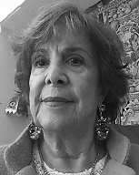
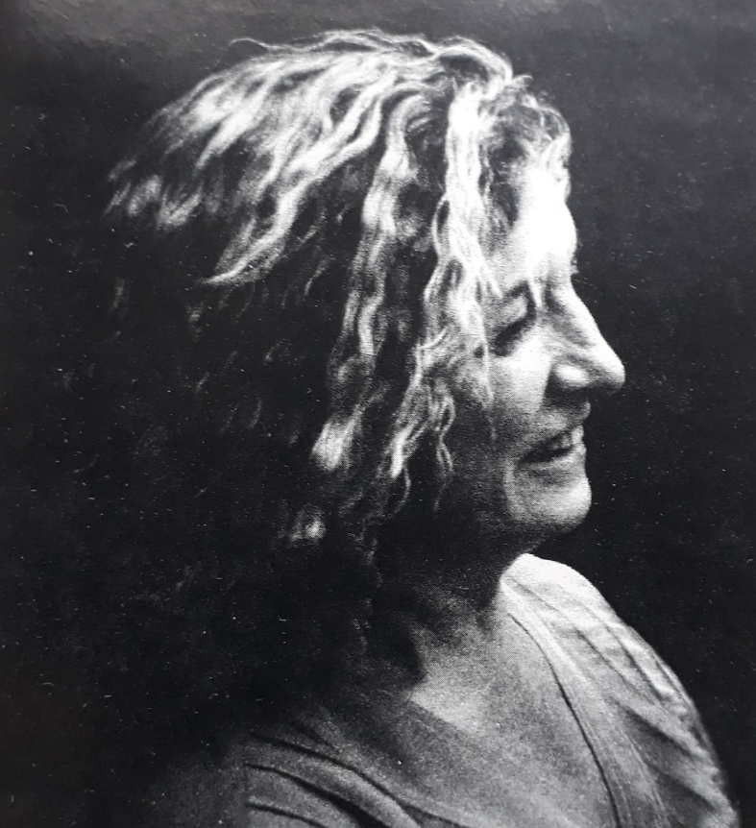

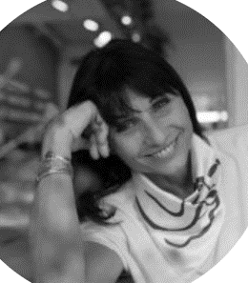
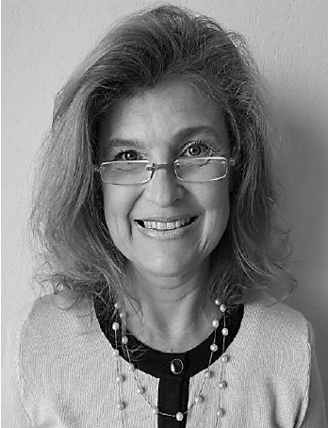
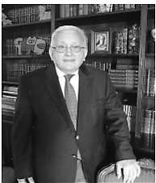
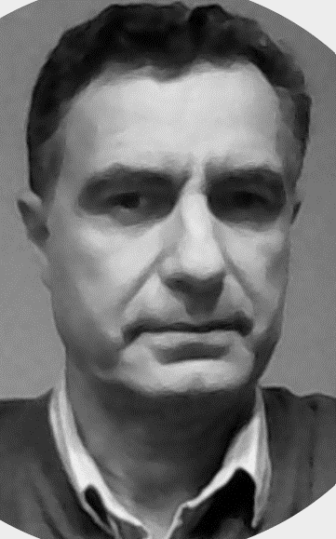
Argentina
Roberto Yunes
Carolina Remedi
Viviana Chiappe
Edith Serfaty
Claudio Michanie
Norma Echavarria
Fernando Zan

Slide 4
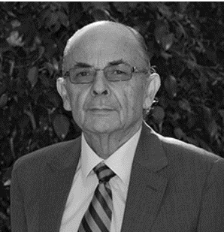
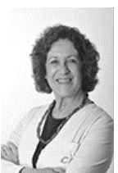
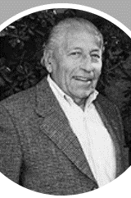
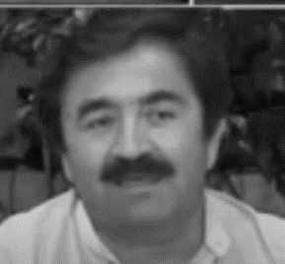
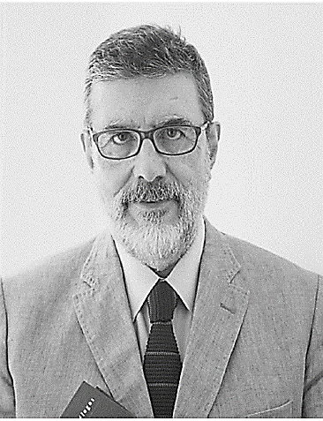
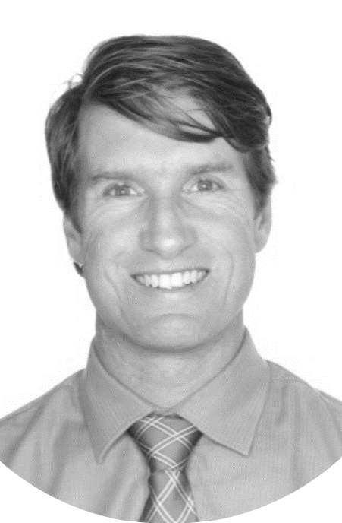
Chile
Arturo Grau
Sergio Zamora
Humberto Guajardo
Flora de la Barra
Hernan Montenegro
Matias Irarrazaval

Slide 5
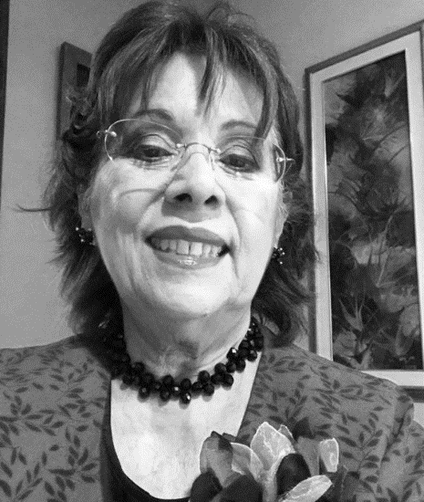
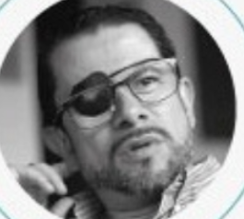
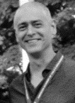
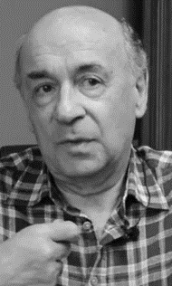
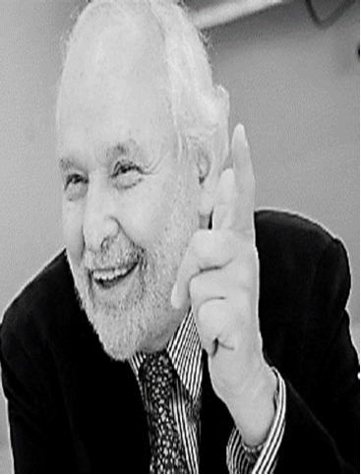
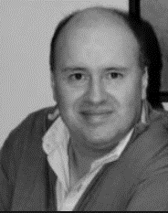
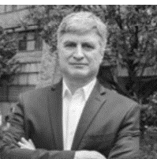
Colombia
Javier Auli
Roberto Chaskel
German Casas
Elizabeth Trillos
Juan D. Palacio
German Puerta
Miguel Uribe

Slide 6
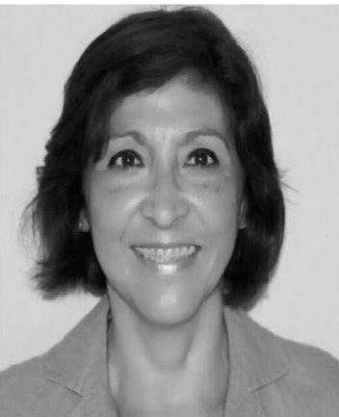
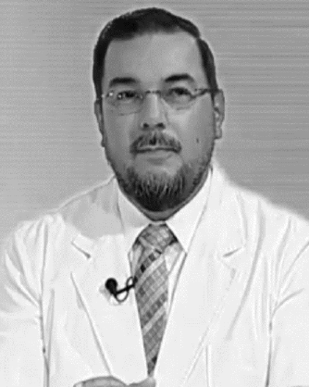
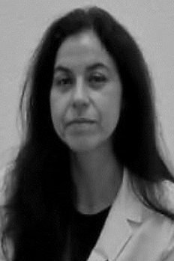
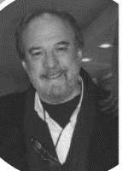
Ecuador- Mexico - Paraguay
Victoria Valdez
Fabrizzio Delgado
Rosa Elena Ulloa
Jose Arias

Slide 7
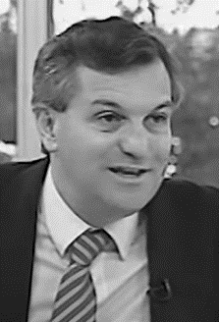
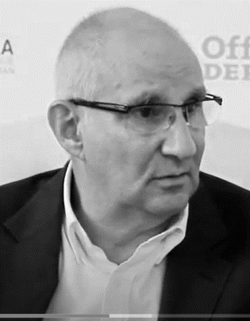
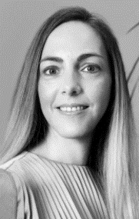
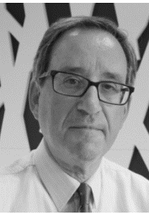
Uruguay -Spain
Ariel Gold
Jorge Barudy
Regina Sala
Joaquin Fuentes

Slide 8
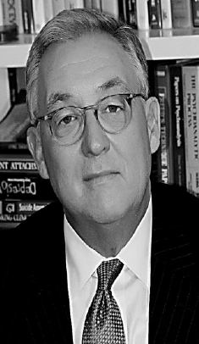
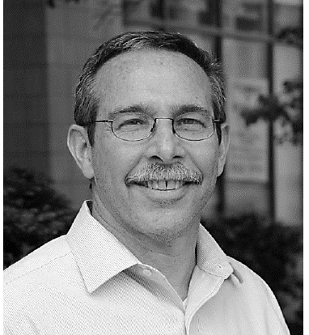
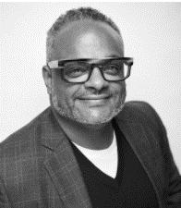
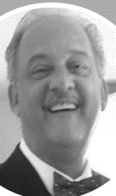
USA - Venezuela
Eugenio Rothe
Boris Birmaher
Angel Caraballo
Edgar Beldfort

Slide 9
Cheers!- Congratulations
Salud!- Felicitaciones

